Slide 1
Module 3 Windows Forensic Analysis
Elton Booker, CISSP
Lead Forensic Analyst

Slide 2
Windows File System Basics

Slide 3
File System Overview
Helps specific OSs determine layout
Layout determines recovery methods
File systems inform investigations
Need to understand file systems and operating system layouts

Slide 4
Windows Filesystem Overview
FAT 12/16
MS-DOS, Win95/98/NT/2000
FAT32
ExFAT
2008/2012/Vista/Win7/Win8
Cheat sheet on Blackboard
Windows NT File System (NTFS)
WinXP/2003/2008/2012/Vista/Win7/Win8
Server 2012
Win95 (OSR 2), Win2000
WinXP/2003/Vista/Win7/Win8
Cheat sheet on Blackboard
ReFS

Slide 5
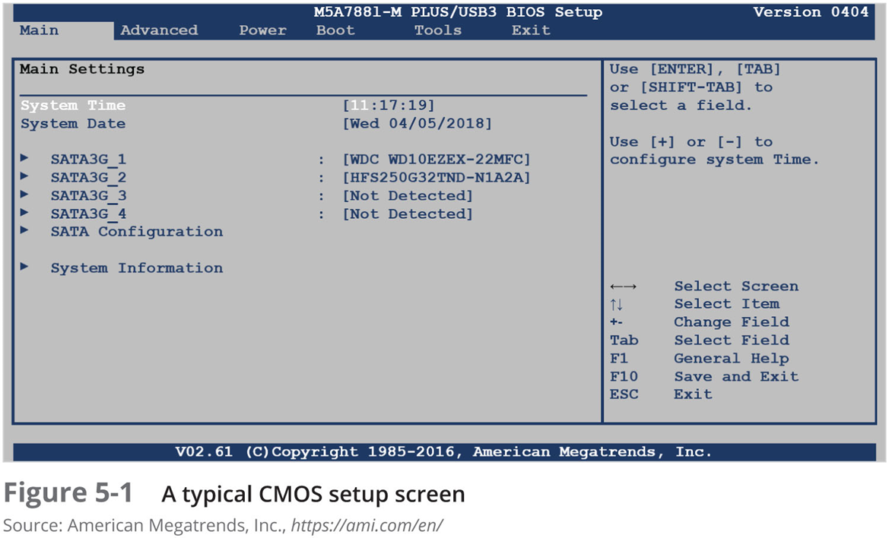
Understanding the Boot Sequence
Notes:
Complementary Metal Oxide Semiconductor (CMOS)
Computer stores system configuration and date and time information in the CMOS
When power to the system is off
Basic Input/Output System (BIOS) or Extensible Firmware Interface (EFI)
Contains programs that perform input and output at the hardware level
Bootstrap process
Contained in ROM, tells the computer how to proceed
Displays the key or keys you press to open the CMOS setup screen
CMOS should be modified to boot from a forensic floppy disk or CD

Slide 6
Understanding Disk Drives
Disk drives are made up of one or more platters coated with magnetic material
Applies to hard drives only
SSDs will be covered in another module
Disk drive components
Geometry
Head
Tracks
Cylinders
Sectors

Slide 7
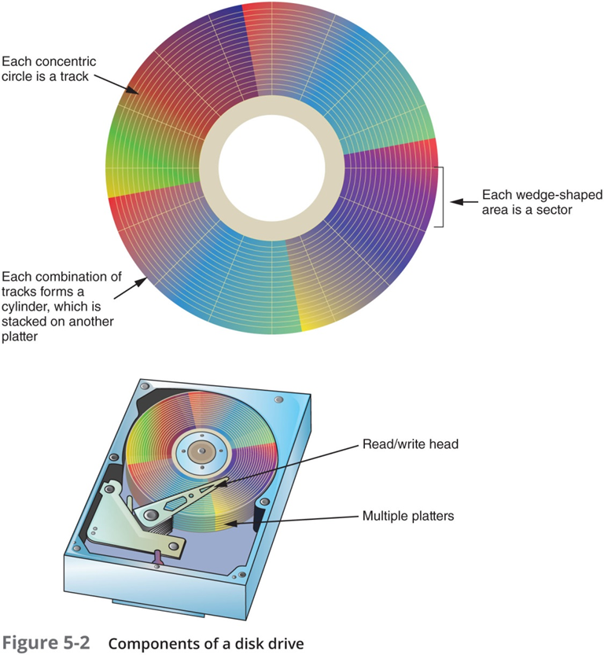
Disk Drive Components

Slide 8
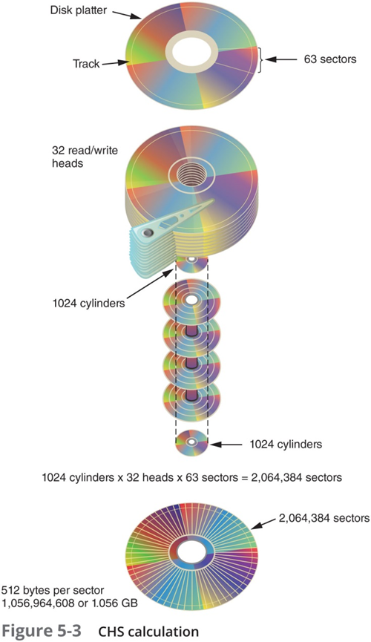
CHS Calculations
Notes:
ZBR improvements

Slide 9
Microsoft File Structures
Physical sectors grouped into clusters
Clusters 512 - 32,000 bytes each
Depend on disk size and file system
Partitions are logical drives
Three primary and one extended
Hidden partitions
Partition gaps
Partition table is in the MBR
Sector 0 of the disk drive
Notes:
Combining sectors minimizes the overhead of writing or reading files to a disk

Slide 10
FAT Characteristics
File Allocation Table (FAT)
File structure database that MS designed for floppy disks
Outmost track
Filenames, directory names, date and time stamps, starting cluster number, and attributes
Cluster size varies
According to disk size and file system

Slide 11
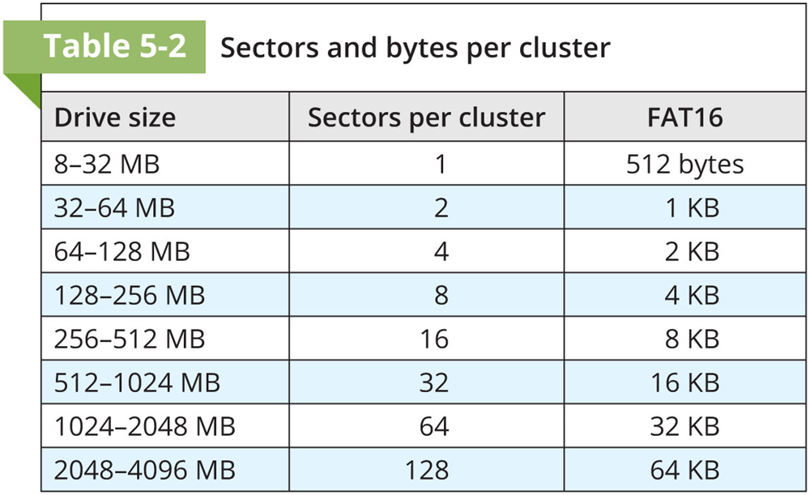
FAT Cluster Sizes

Slide 12
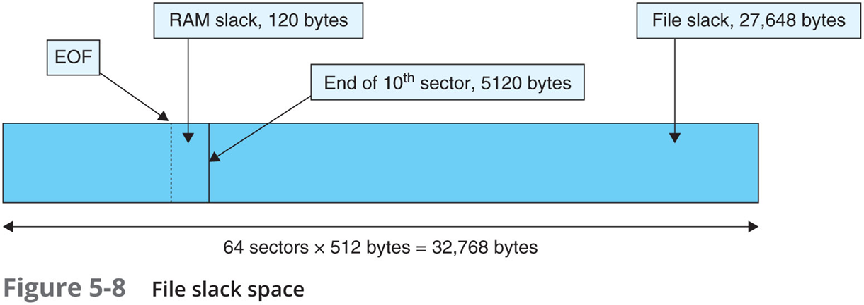
FAT File Slack
Notes:
Microsoft OSs allocate disk space for files by clusters
Results in drive slack
Unused space in a cluster between the end of an active file’s content and the end of the cluster
Drive slack includes:
RAM slack and file slack

Slide 13
FAT Basics
Allocated vs. Unallocated clusters
FAT chain broken or fragmented
Next available cluster assignments
Deleted files marked with 0xE5
Deleted file becomes unallocated space
Recovery possible until file overwritten

Slide 14
Introduction to NTFS

Slide 15
NTFS Basics
NTFS introduced with Windows NT/2000
Improvements over FAT
Additional file information
More control and security
Journaling file system (resiliency)
Everything considered a file
Partition Boot Sector and MFT
Smaller clusters

Slide 16
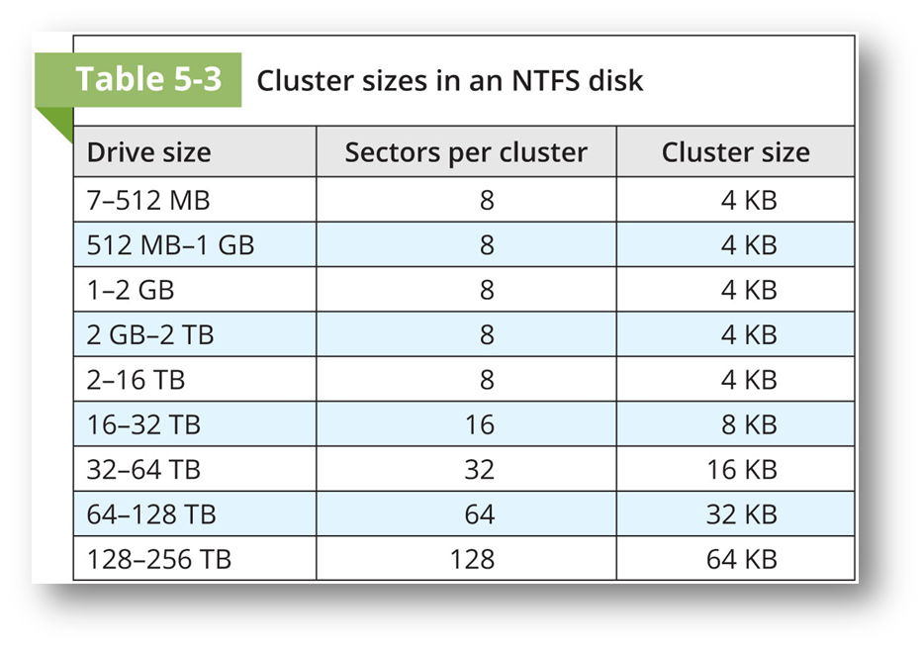
NTFS Cluster Sizes

Slide 17
Master File Table (MFT)
Contains info about all files on disk
First 15 records reserved
Records in the MFT called metadata
Each MFT entry 1,024 bytes
Resident (512 bytes)
Nonresident (data runs)
Deleted files renamed and move to recycle bin

Slide 18
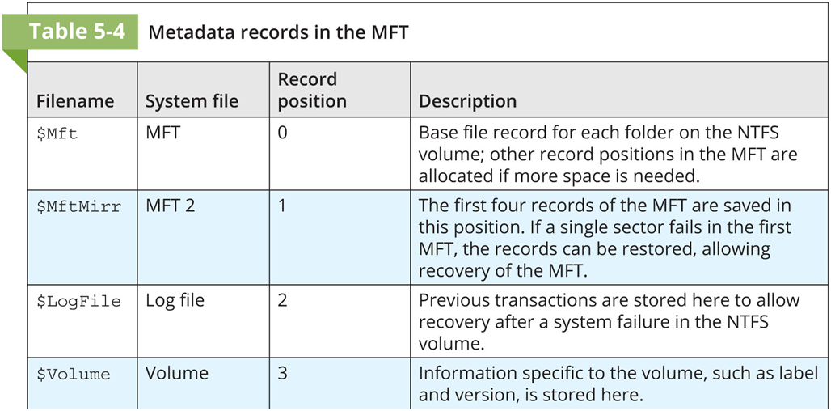
MFT Metadata Records

Slide 19
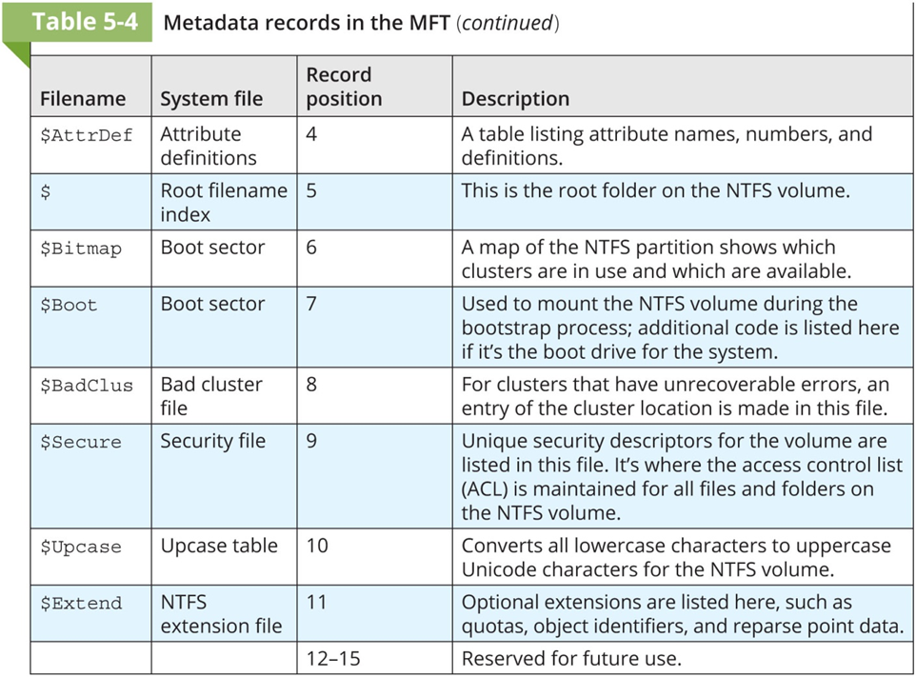
MFT Metadata Records

Slide 20
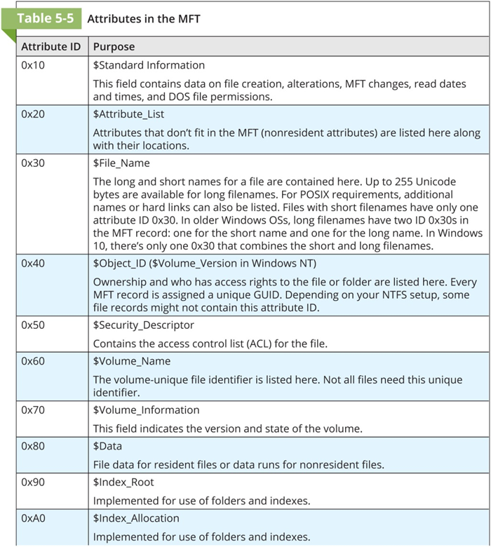
MFT Attributes

Slide 21
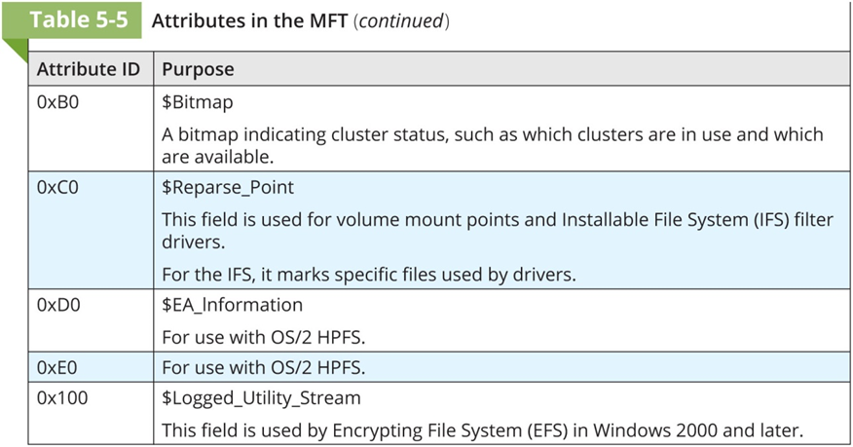
MFT Attributes

Slide 22
Master File Table (MFT)
Primary catalogue file
Disk space allocated and utilized
How files are created and deleted
How metadata is stored and updated
Each NTFS volume has its own MFT
Requires raw disk access to acquire $MFT

Slide 23
MFT Contents
Primary source of metadata in NTFS
References everything about a file
Timestamps
File size
Attributes (e.g. permissions)
Parent directory
contents

Slide 24
MFT Structure
Standard HDs with 512-byte sectors
A series of 1024-byte records or “entries”
One record for every file and directory
16 entries reserved for NTFS artifacts
E.g. $MFT, $LogFile
Artifacts known as attributes

Slide 25
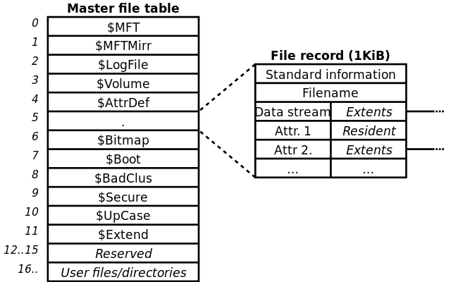
MFT Entries

Slide 26
MFT Entry Contents
Record type (file or directory)
Record # (integer)
Parent record #
Active/Inactive flag
Attributes (metadata)

Slide 27
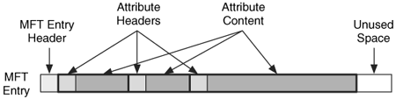
Entry and Attributes
$STD_INFO
$FILE_NAME
$DATA

Slide 28
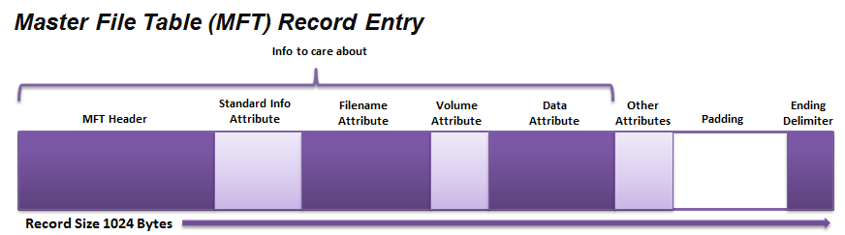

Slide 29
Deleted Files
Deleting a file causes its MFT record to be marked “inactive”
Nothing else is changed, until record re-used
File’s contents/metadata can be recovered
NTFS re-uses entries before creating new ones

Slide 30

Timestamps
MACE timestamps
Modified, Accessed, Created, Entry Modified
An MFT entry will always have at least two sets of attributes containing MACE timestamps
STANDARD_INFORMATION ($SIA or $SI)
FileName (FNA, FILE_NAME, or $FN)

Slide 31
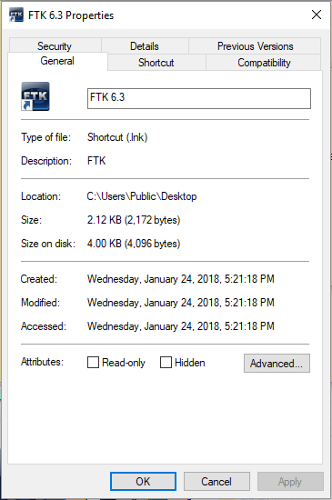
$SI Timestamps
Timestamps
Created
Accessed
Modified
Entry Modified not visible in Explorer
Forensic Tools show this timestamp

Slide 32

MACE Timestamps
Modified
Accessed
Created
Entry Modified
When the contents of a file were last changed
When the contents of a file were last read
When the file was “born”
When the MFT entry changed (rather than the file contents)

Slide 33
Accessed Timestamp
Windows XP+ no longer update this timestamp by default (GPO)
This can be updated in the registry, but may take up to an hour to update
Antivirus can modify times and throw off investigations
Don’t trust these timestamps

Slide 34
$SI and $FN Timestamps
$SI timestamps are easily altered
$FN timestamps require a complex and indirect process to modify
Inconsistencies may exist between the $SI and $FN timestamps
Some attackers will double-timestomp which doesn’t require raw disk access

Slide 35
$FN Timestamps
Refer to the MFT entry for the filename itself
NTFS actually maintains multiple sets of file name attributes
Full, case-sensitive long filename
MS-DOS 8.3 short file name

Slide 36
Time-Stomping
Only the $SI timestamps are available through the Windows API
Programs can alter these timestamps
Timestomping
SetMACE can alter timestamps
Malware droppers and installers often automate this process and replace timestamps from system files

Slide 37
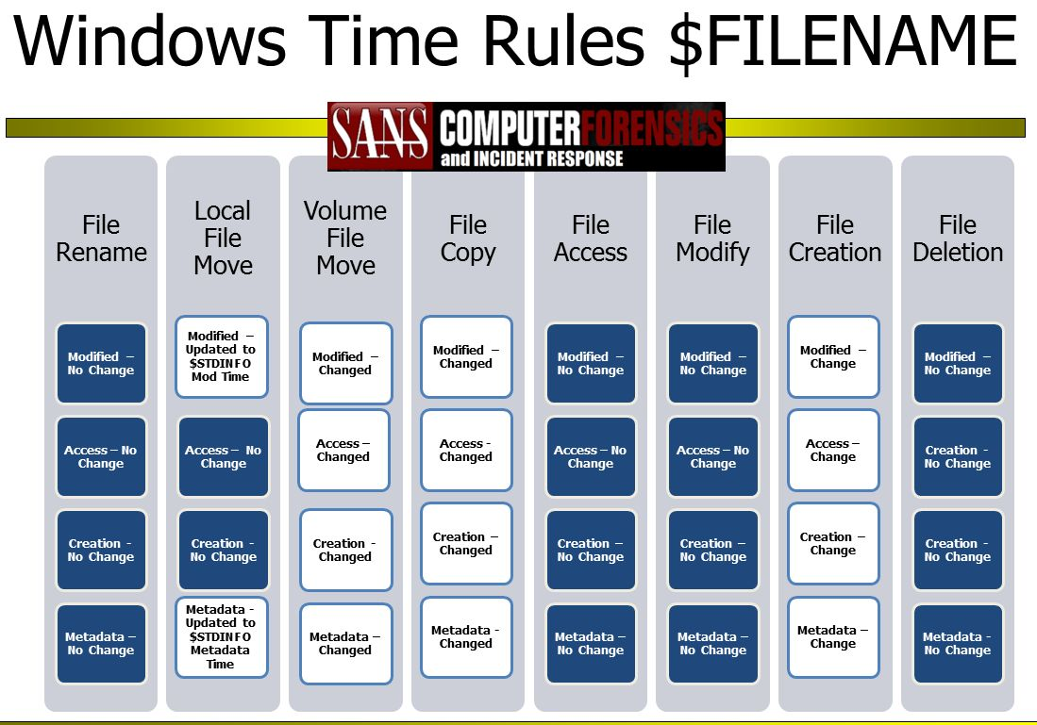

Slide 38
Resident Data
MFT entry contains 1024 bytes
That’s enough for complete files (700-800 bytes) to be resident in the MFT
A resident flag exists in the MFT entry
If less than 1024 bytes – slack space may exist (old entry or one that is non-resident)

Slide 39
Alternate Data Streams
Additional named $DATA attribute in a file’s MFT entry
Each attribute can point to a unique set of cluster runs
All streams share the same timestamps and $FN and $SI attributes

Slide 40

Known Alternate Stream Names
Browsers append a stream to downloaded files
Zone.Identifier
Windows Explorer uses this data to determine the origin of a file and enforce security controls

